Slide 1
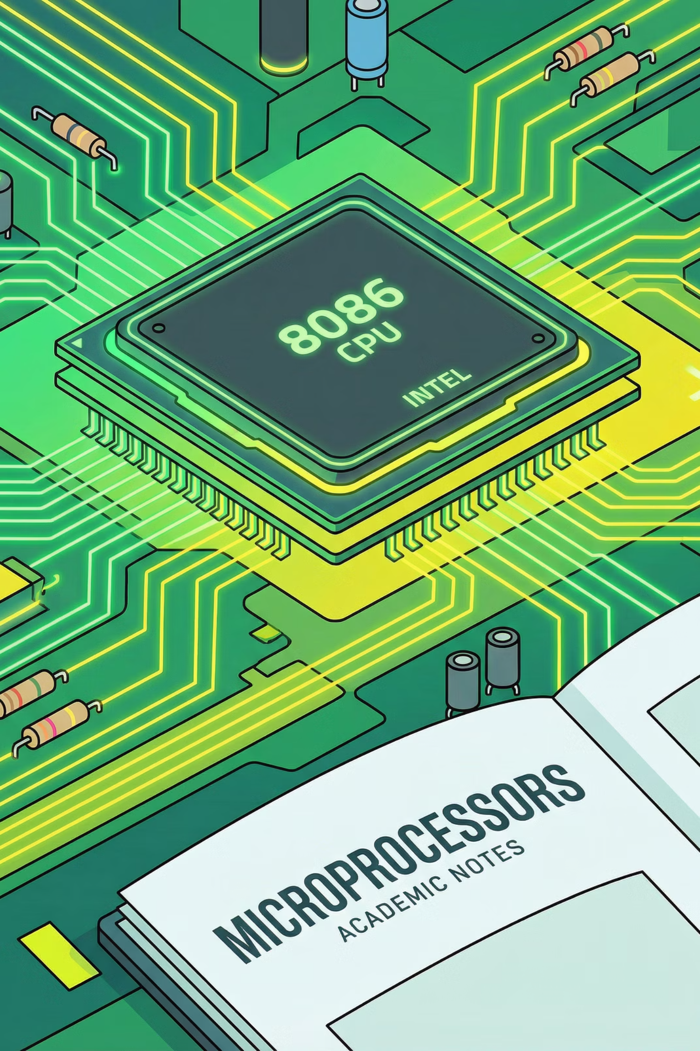


String Reversal & Palindrome Checker using 8086 Assembly Language
Presented by:
Muhammad Abdullah
Amin bin Rashid
Rubbani Gul
24-CS-172
24-CS-157
24-CS-052

Slide 2

The Challenge: String Manipulation in Assembly
Problem Statement
Efficient string manipulation is crucial in low-level programming. This project addresses:
Reversing a user-input string
Determining if the string is a palindrome
Implementing these tasks using 8086 Assembly Language

Slide 3


Project Objectives: Precision and Clarity
User Input
String Reversal
Accept string input from the user.
Implement pointer-based logic for efficient string reversal.
Palindrome Check
Clear Output
Accurately verify if the string is a palindrome.
Display informative messages to the user.

Slide 4
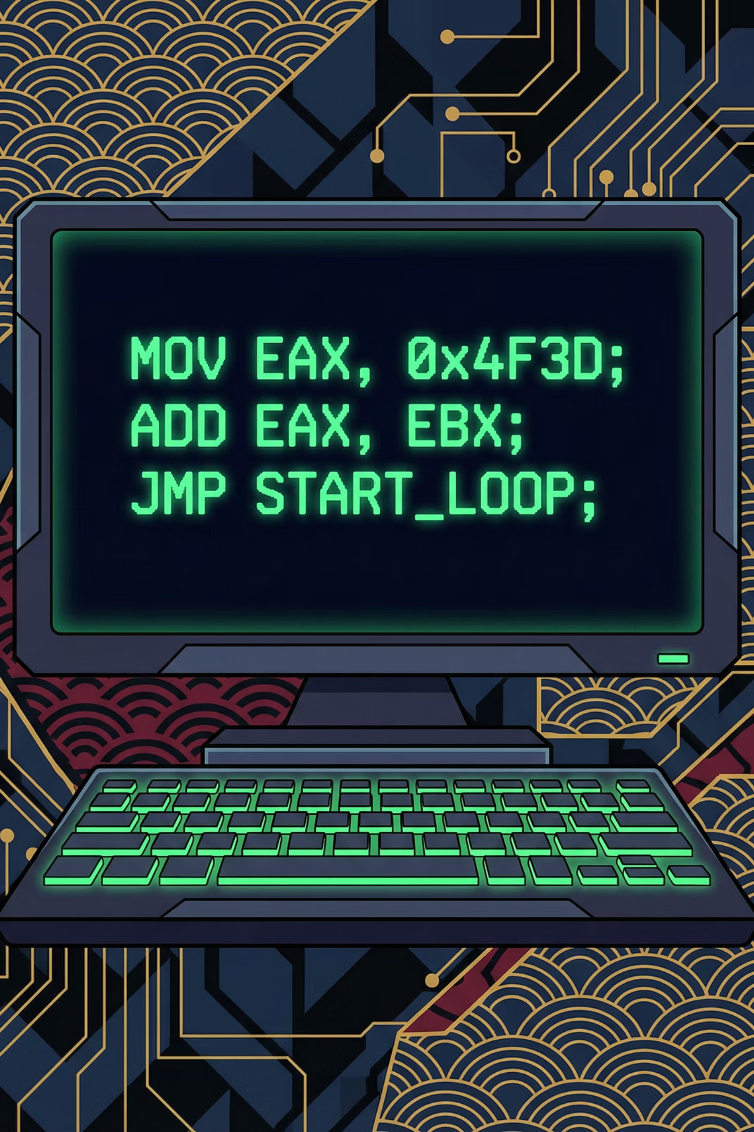
Methodology: Leveraging 8086 Architecture
DOS Interrupts
Utilize INT 21h for streamlined input/output operations.
Buffered Storage
Store strings efficiently in a buffered format.
Pointer Registers
Employ SI and DI as dedicated pointers for string traversal.
Modular Design
Separate procedures for string reversal and palindrome checking, enhancing code organization.

Slide 5

Key Assembly Instructions
Data Movement & Arithmetic
Control Flow & Subroutines
MOV: Copy data
CMP, JUMP (JE, JNE, etc.): Conditional execution
ADD, SUB: Basic arithmetic
INC, DEC: Increment/Decrement values
CALL, RET: Procedure calls and returns
INT 21h: System service calls

Slide 6


Algorithmic Flow: Visualizing Logic
Initialize Pointers
Loop until SI ≥ DI
Swap characters
Increment SI, Decrement DI
End
Initialize Pointers
Loop Until Start>=End
Compare Characters
If Unequal → Not Palindrome
If Equal → Move Pointers

Slide 7


Execution Walkthrough: Output Screenshots

Slide 8



Final Results: Precision Achieved
String Reversal
Program successfully reverses strings using pointer manipulation.
Palindrome Accuracy
Accurately determines if a string is a palindrome or not.
Robust implementation within the constraints of 8086 Assembly Language.

Slide 9



Conclusion: Insights from Low-Level Programming
Learning Outcomes
Deepened understanding of 8086 architecture
Proficiency in assembly language programming techniques
Mastery of memory management and pointer usage
Importance of Assembly
Critical for embedded systems and kernel development
Enhances comprehension of computer fundamentals
Optimizing performance at the hardware level

Slide 10
Thank You

